Slide 1



DevOps in the Cloud for the .NET Developer
Scott Addie | Senior Content Developer | @Scott_Addie

Slide 2
What is DevOps?
People
Products
Process
Notes:
Union of people, process, & products to enable continuous delivery of value to end users
Stated a different way: People following a process enabled by products to deliver value to end users

Slide 3
The fallacy of right-click > Publish
Doesn’t scale beyond 1 person

Slide 4

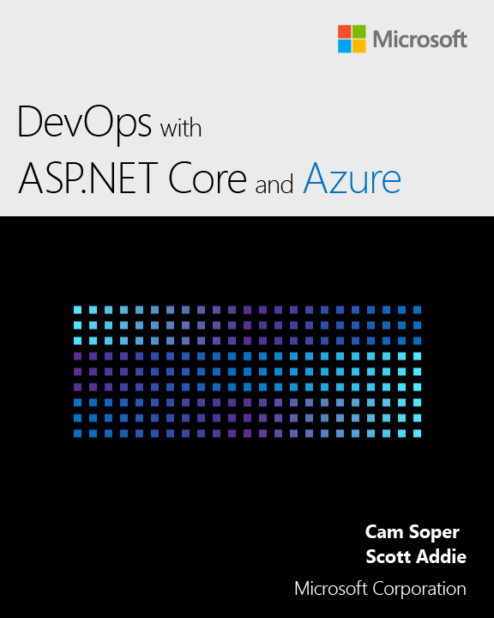
Resources
Docs @Scott_Addie
aka.ms/dotnet-secret-mgr
aka.ms/az-key-vault
Slides
aka.ms/app-secrets-slides
Code
aka.ms/app-secrets-code

